Slide 1
How Not To Kill Your Dog
Team V
Ross Adam
Andrew Gardner
Nicole Kearns
Mamas Nicolaou
Aset Sarsengaliyev

Slide 2
Project Background
“How Not To Kill Your Dog” is the macabre title for our veterinary study application.
Unlike many other team projects we have been working to provide software for a client: Dr Fiona Dowell from The University of Glasgow Veterinary School.
Currently the Veterinary School, much like our own school, has all of the course’s lectures stored on their respective Moodle site. Dr Dowell however wanted an application that consolidated these lectures in one centralised location.
Eliciting the full requirements required several Client Interviews but the main requirements of the application was to provide both a study and revision tool which would be more engaging than current methods.
The main stakeholders identified will be : the veterinary students who will be using this application throughout their studies; other lecturers and finally I.T. support staff who will interact with this application extensively.

Slide 3
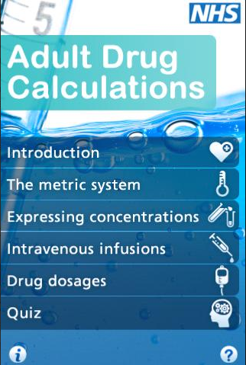
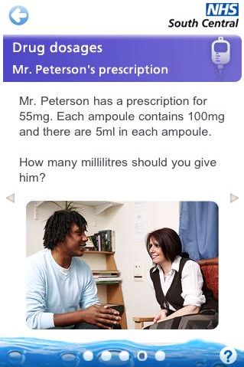
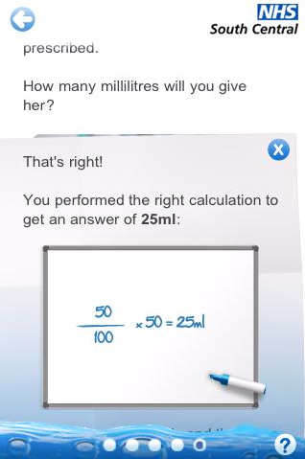
Prior Research
Initially the team agreed that researching current tools could form a basis for our own designs.
Dr Dowell had already presented us with an NHS application which represented what she wanted from the application.
She pointed out that performing Drug Calculations was the element of the course students struggled with the most. So the next step in our research was finding tools which implemented questions or similar methods of testing user’s knowledge.

Slide 4
BBC Bitesize
BBC Bitesize is a revision tool that the Scottish members of the team have great familiarity with.
Bitesize is a tool present on the BBC website that provides revision material for a wide variety subjects within the Scottish, English, Welsh and Northern Irish curriculums.
Information is presented in an easy to understand way. A consistent ‘frame’ of links for quick navigation surrounding the educational content.
Questions are presented in the same way as the educational content. Each question features the question and several radio buttons for selecting an answer.

Slide 5
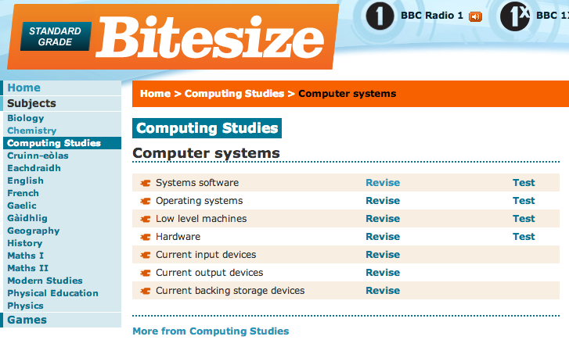
BBC Bitesize Layout

Slide 6
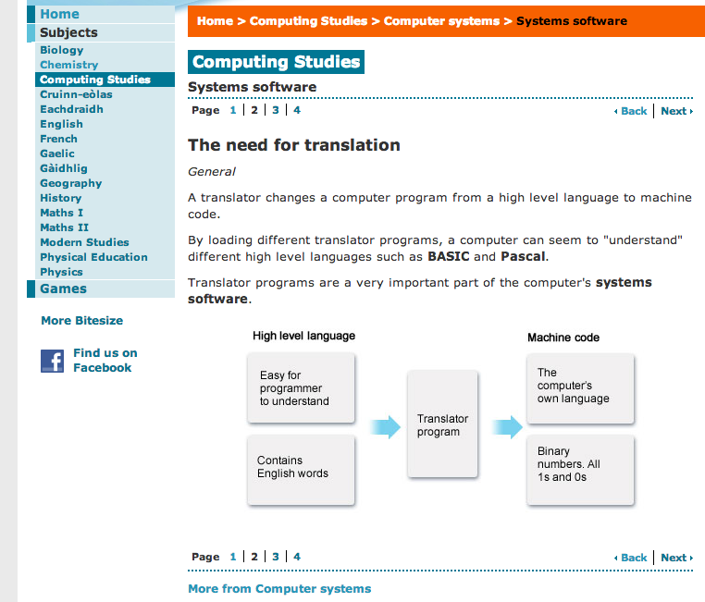
BBC Bitesize Content

Slide 7
Hot Potatoes
The second revision tool the team assessed was the Hot Potatoes application.
This application consists of a suite of programs that can create a variety of different question types.
Unlike Bitesize all content is unique to the user design but it is still hosted on the internet allowing multiple users to access concurrently.
All we took from this design was how to minimise user frustration when creating questions througha simple interface.

Slide 8
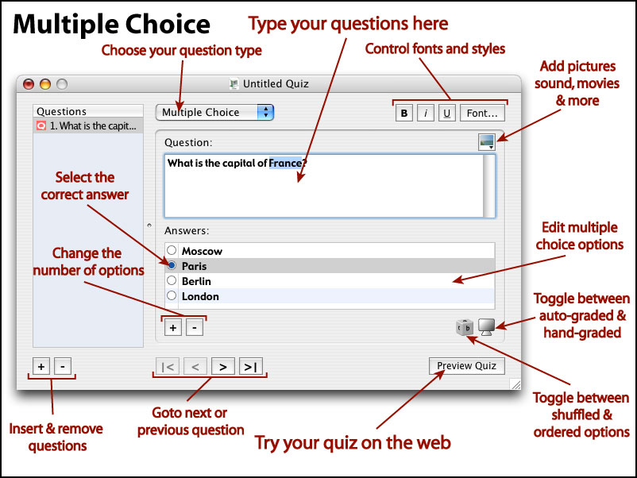
Question Creator

Slide 9
Requirements
The project problem was defined on the project proposals handout at the beginning of the year.
To refine these requirements we met with Dr Dowell to gather more information on the applications requirements and specifications.
These Requirements were:
-A learning application for vet students, providing step-by-step tutorials for different sections of the vet course.
-Simple example questions within each topic to test how much the user is learning about that specific section.
-A larger assessment at the end of all sections to test users on all the content within the application.

Slide 10
Additional Requirements
Rather than hard code the client's course slides into the application the team pitched her an alternative idea.
We aimed to achieve this by implementing a form of content management system.
From this we drew up an extended list of requirements that encompassed the generality we wanted to achieve.
Our Requirements are grouped by three different types of user:
1. Student
2. Content Administrator
3. User Administrator

Slide 11
Final Requirements
Student
View Topic
View Slides
View Questions
Answer Questions
User Administrator
Add User
Delete User
Set Permissions

Slide 12
Final Req. Cont.
Content Administrator
Add Topic
Edit Topic
Delete Topic
Add Slide
Delete Slide
Add Question
Edit Question
Delete question

Slide 13
Design
Prior to this project the team had no experience with CSS.
We made the decision to use Twitter Bootstrap to implement our interfaces.
Initially there were several mock ups hand drawn and then refined with a wire frame tool and sent to the client for feedback.
The client agreed on two designs that prominently featured the slide content with questions attached below each slide.

Slide 14
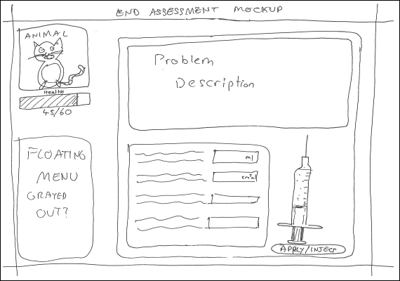
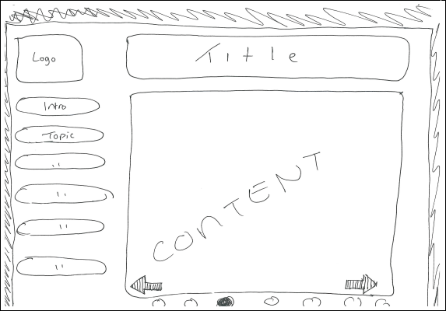
Initial Design
Each design contains a consistent frame that encloses the main content.
This frame allows for quick navigation of the application.

Slide 15
Dynamic Design
Revision Section
The main element of our application is the Content Slider which displays course content.
Attached to each slide is a series of questions displayed beside the content.
Assessment Section
This page features a series of dynamically generated questions filled from a database.
The “game-ification” element of this page comes in the form of a health bar for an animal that decreases as questions are incorrectly answered.

Slide 16
Design Reiteration
Meeting with the client throughout the design stage allowed for constamt improvement of our interface.
Dr Dowell had several opinions on our design:
The colouration of the application.
The layout of our content pages.

Slide 17
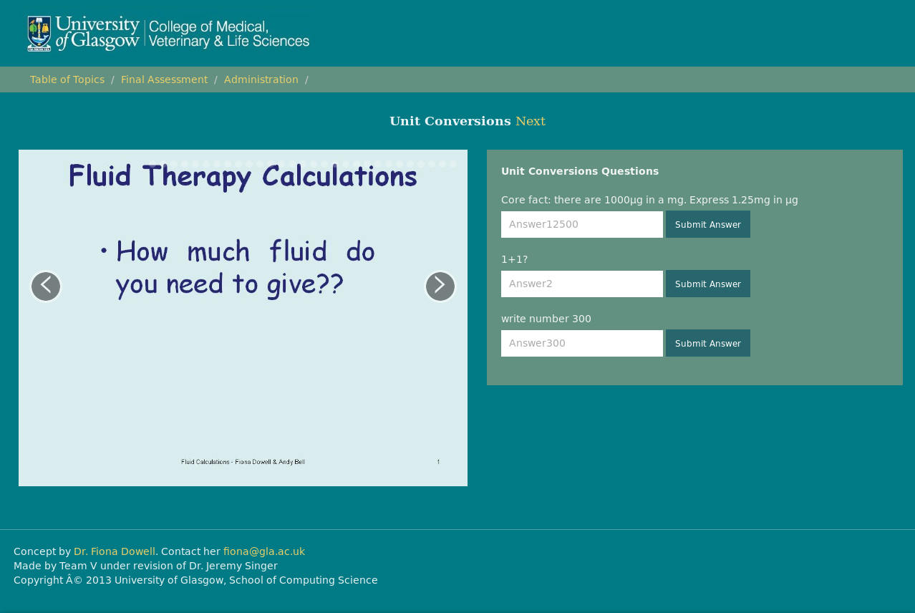
Final Design

Slide 18
Implementation (Mamas)

Slide 19
Evaluation
Why Evaluate? As mentioned before we have been developing for an external client so meeting their needs has been our key concern.
To evaluate our application we used three distinct groups: the Developers, client and finally users (a combination of Computing Science students and other students.
The evaluation itself was a task sheet consisting of several tasks for the subject to complete.
It was created by taking each of the requirements for our application and constructing a task centring around this requirement.
The tasks were split into two distinct sections:
Administrator
Student

Slide 20
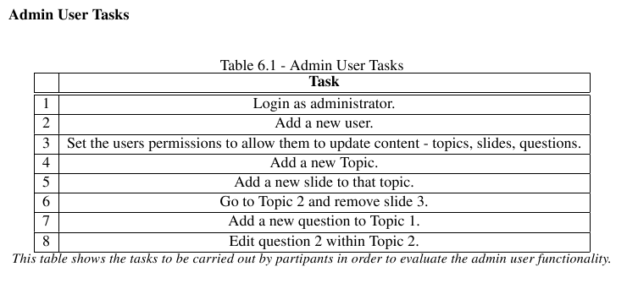
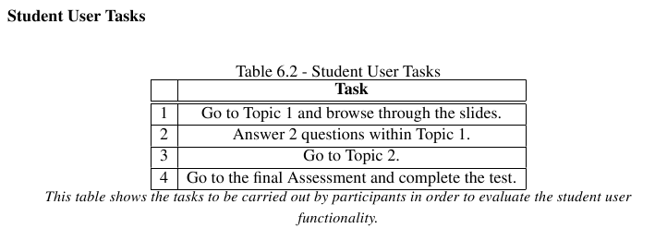
Tasks

Slide 21
User Evaluation
The client evaluation was conducted at our final client meeting on a local host running on one of our laptops.
Student evaluations took place in the lab with multiple users connecting to the application concurrently.
Results
Overall our application was well received by both the client and students.
The team also created a follow up questionnaire for subjects to answer once they had finished the tasks. They graded various aspects of the application from Very Easy (1) to Very Difficult (5).
Average results for each question were within the range of 1 to 3.

Slide 22
User Feedback
1. Inclusion of a “Submit All” button.
2. Enhanced Visual Feedback.
3. Custom user Groups for application permissions.
4. Categorising questions according to difficulty.
5. Creating a “How To” section describing how to use each function.

Slide 23
Future Work
1. Implement Client feedback.
3. Add support for audio and video contact.
4. Make our application compatible with tablets and smart phones.
5. Allow the handling of more generic content.

Slide 24
Conclusion
Team V believes that our project has been a great success.
After evaluating the application with the client it is evident that all the requirements have been met.
The only remaining part of our project we have to complete is assisting in the integration of the program into the Veterinary School system.

